Slide 1
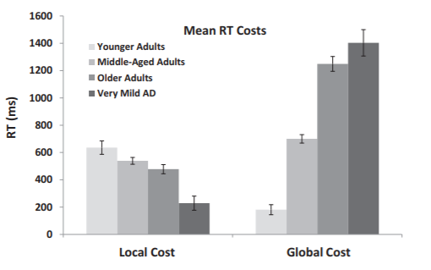
Introduction
Attentional task switching can be very useful for looking at age differences
The Consonant Vowel/Odd Even (CVOE) switch task provides participants with a bivalent stimulus (O 27) with instruction to attend to either the letter or number and classify this as a consonant/vowel or an odd/even
Pure Block vs Switch Block
Huff et al. (2015) compared local and global switching costs across age groups and older adult with mild AD on RTs and errors
Local Switch Costs – switch trials minus non switch trials within the switch block, a task-set reconfiguration cost
Global Switch Costs - nonswitch trials minus pure trials, a task-set maintenance cost
This was done using the alternating runs paradigm. (CV,CV,OE,OE,CV,CV…)
Huff et al. (2015) - Results
(2067) Namias
Notes:
Task set reconfiguration is the amount of time it takes to change task goals. So from CV,CV to CV,OE here we are only looking at the switch block
Think of task set maintenance as measuring differences in maintaining multiple configurations versus only one configuration so CV,OE,CV to CV,CV,CV and here its in the switch vs pure blocks
The results in the study showed a decrease in local costs and an increase in global cost across age groups

Slide 2
Pure Block
(CV -> CV / Letter -> Letter)
Switch Block
(CV -> OE / Letter-> Number)
1st Stimulus
1st Stimulus
Q
Consonant
P
Vowel
Q
Consonant
Odd
P
Vowel
Even
Letter
B 18
D 37
B = consonant, q = correct key press
D = consonant, q = correct key press
2nd Stimulus
2nd Stimulus
Q
Consonant
P
Vowel
Q
Consonant
Odd
P
Vowel
Even
Number
A 20
O 13
(2067) Namias
A = Vowel, p = correct key press
13 = Odd, q = correct key press

Slide 3
Block Types
Alternating Runs Switch Task
Task instructions change after every other trial
i.e., CV, CV, OE, OE, CV, CV

Slide 4
Block Types
Alternating Runs Switch Task
Task instructions change after every other trial
i.e., CV, CV, OE, OE, CV, CV
Every other trial is a switch trial

Slide 5
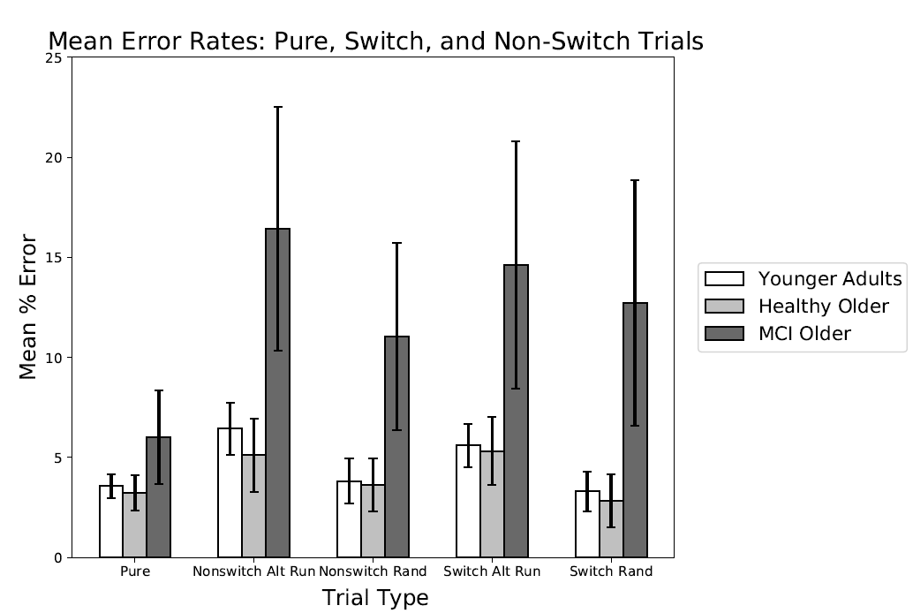

Slide 6
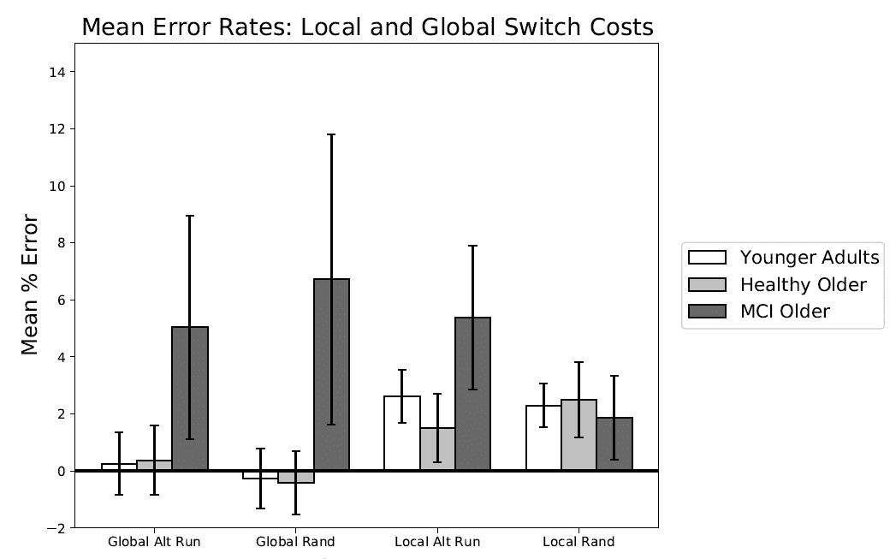

Slide 7
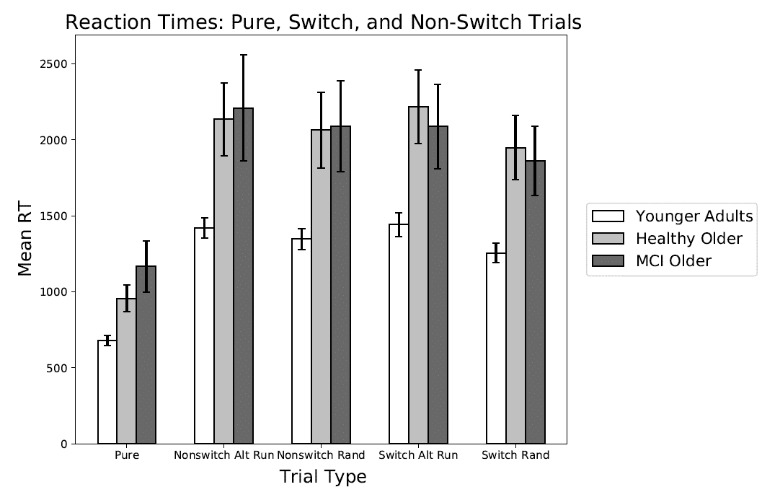

Slide 8
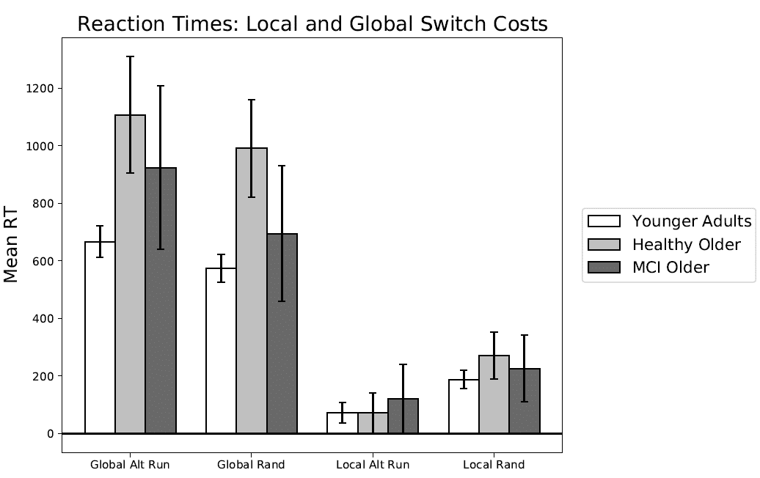

Slide 9
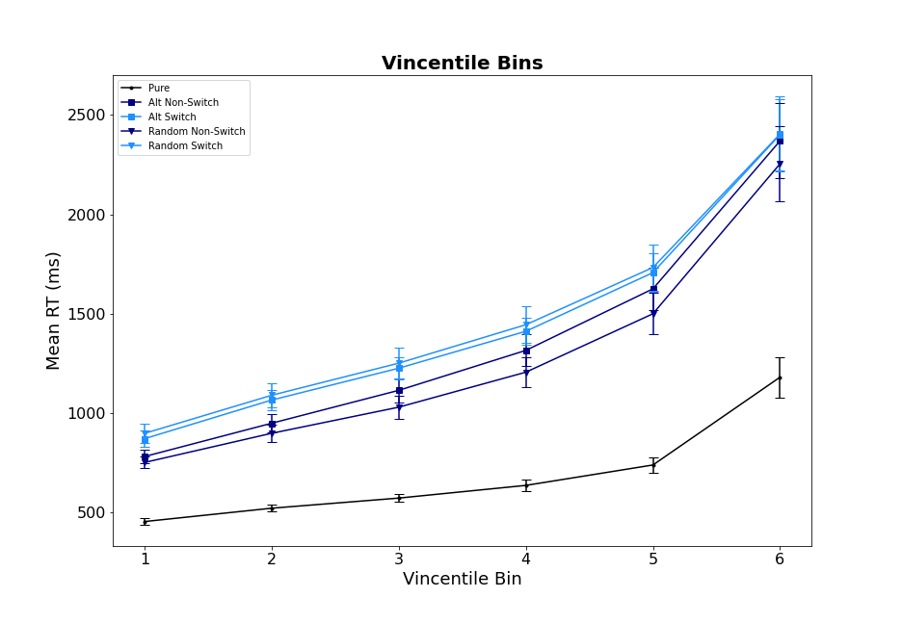
Younger Adult Vincentiles

Slide 10
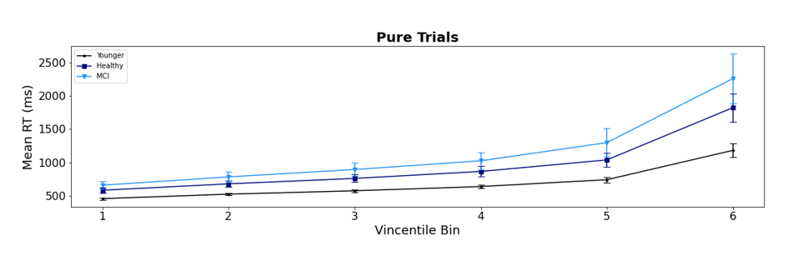
All Groups Vincentiles -- Pure

Slide 11
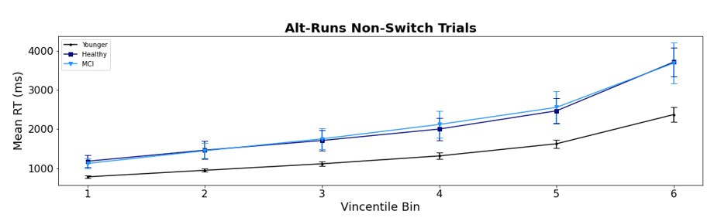
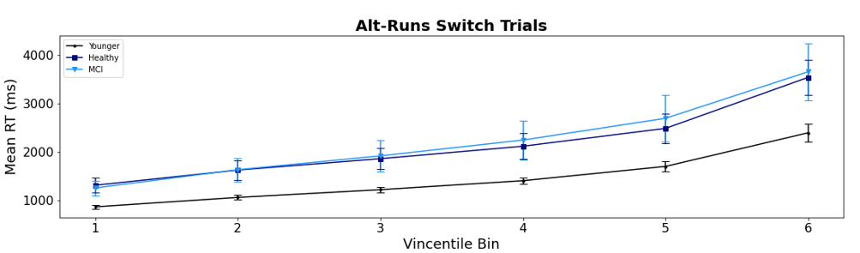
All Groups Vincentiles – Alt Runs

Slide 12
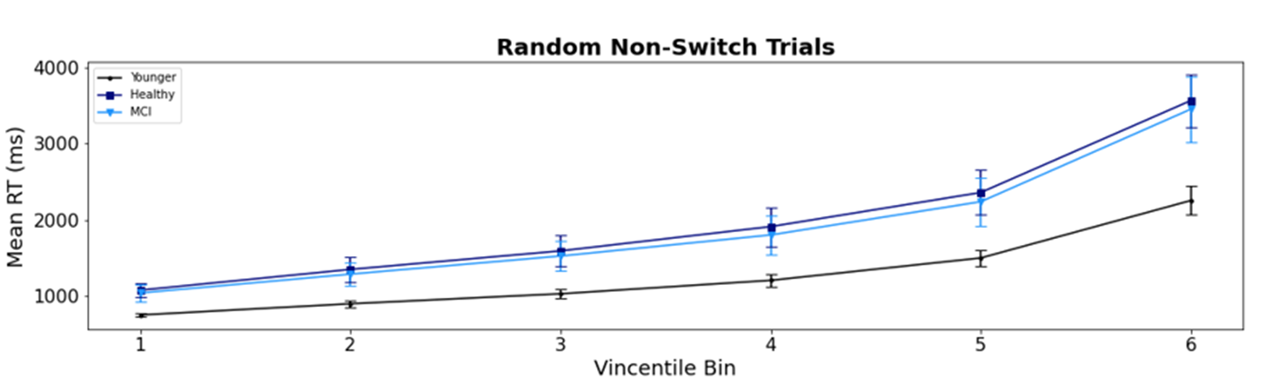
All Groups Vincentiles – Alt Runs

Slide 13
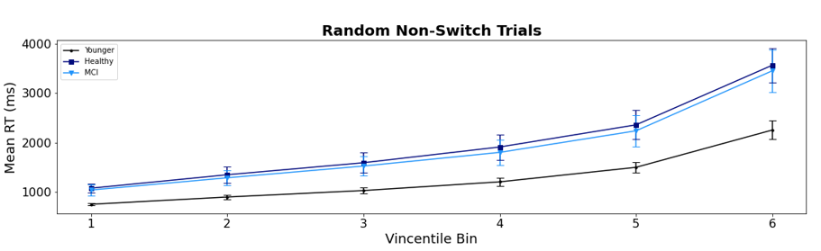
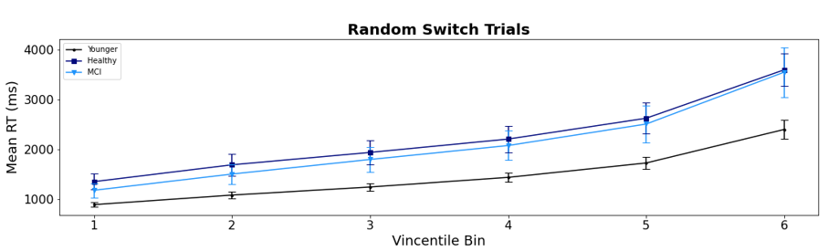
All Groups Vincentiles – Random

Slide 14

All Groups Vincentiles – Random

Slide 15
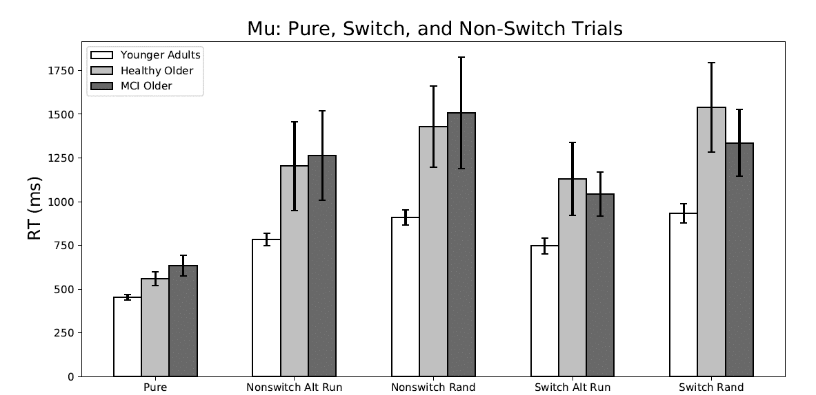

Slide 16
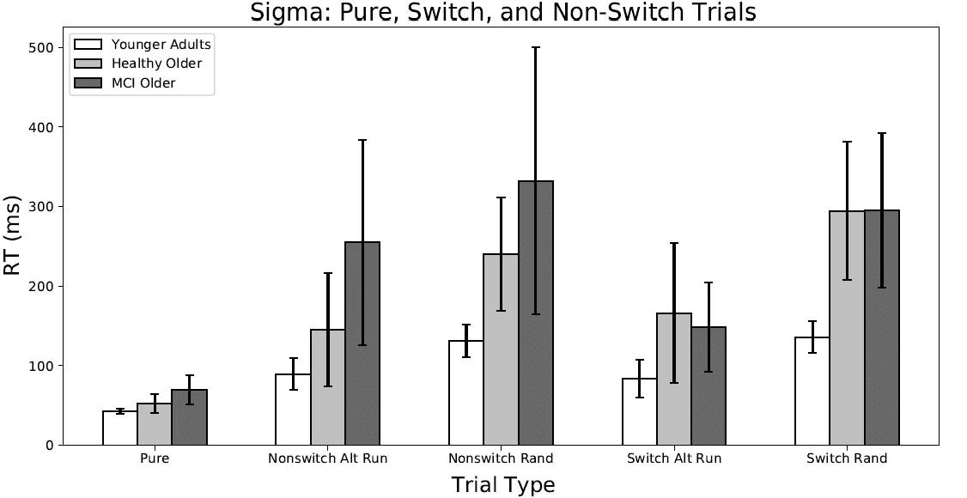

Slide 17
